Slide 1

Stress control
A Mathematical Introduction to Signals and Systems
A Mathematical Approach to Classical Control
Group 6 – Declan COlwell, Troy Giorshev, Chelsey Kurylo, Adam gronowski
http://www.wrha.mb.ca/healthinfo/healthheadlines/2017/170224-managing-stress-and-anxiety.php

Slide 2
Application Area
Over 25% of Canadians between 18 and 64 perceive life stress to be extremely high on a daily basis
Stress has negative health, social, and environmental consequences
Controlling stress could help increase quality of life, productivity, decrease burden on health care system

Slide 3
Types of Stress
Eustress
Positive stress
Distress
Harmful and negative stress
Acute stress
Defense-" fight or flight" stress
Chronic Stress
Long term stress that tends to be suppressed

Slide 4
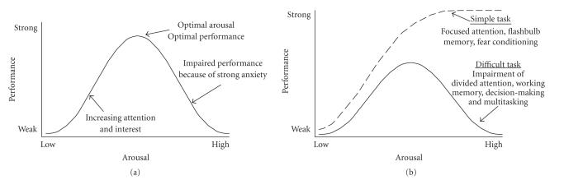
Yerkes-Doson Law – Relationship between stress and performance
Notes:
Relationship between stress and performance
Different daily activities have optimal stress levels
Sleeping-low, doing work- higher

Slide 5
Modelling Body's Response To Stress
Body cortisol levels as black box
  - Cortisol (Stimulant), Clonazepam (depressant) as input, stress level as output
Determine nature of noise (Gaussian)
Filter (LOESS)
Bode plot
Develop transfer function

Slide 6
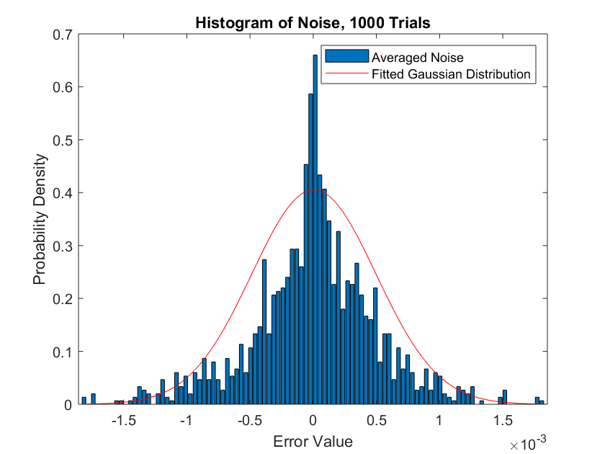
Noise

Slide 7
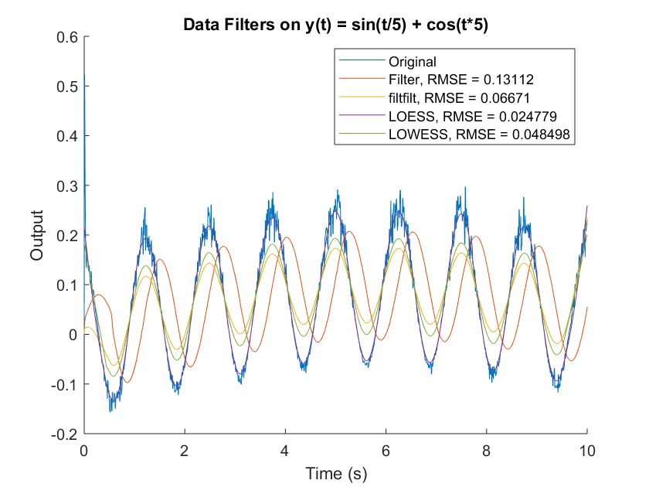
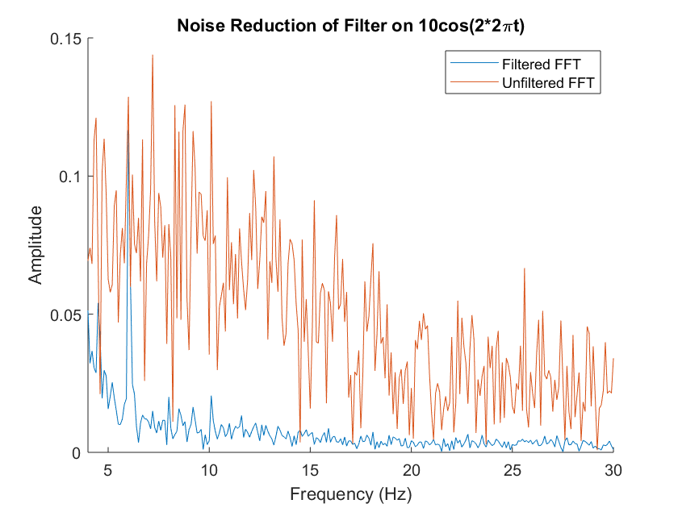
Filter

Slide 8
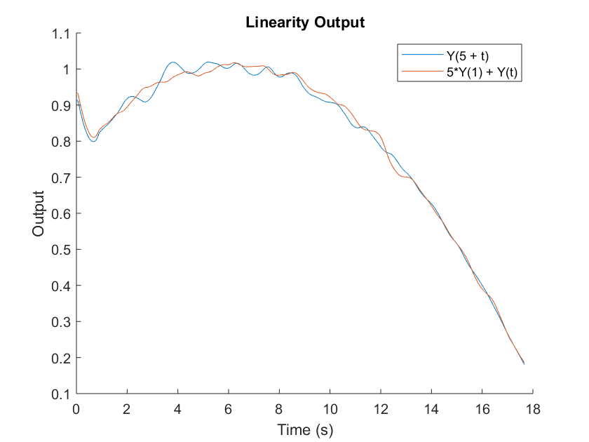
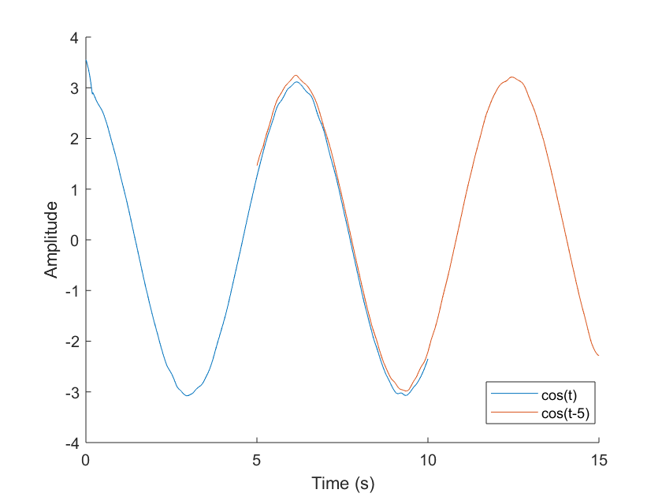
LTI Validation

Slide 9
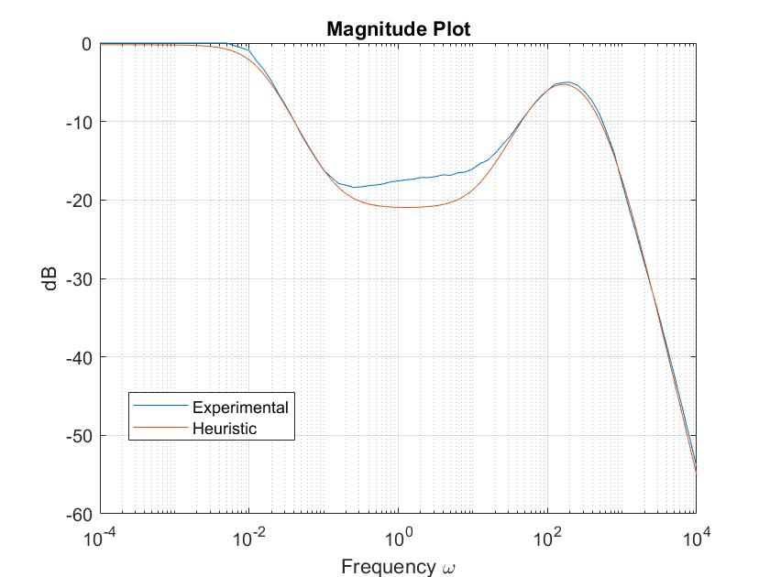
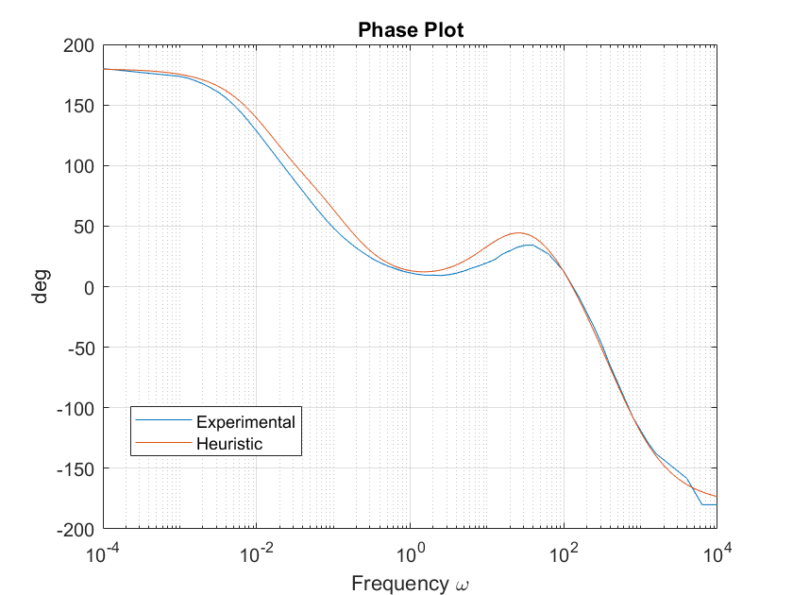
Bode Plot

Slide 10
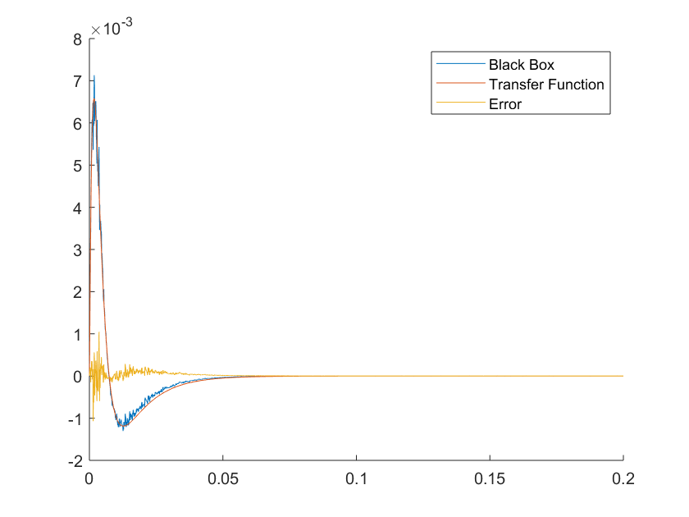
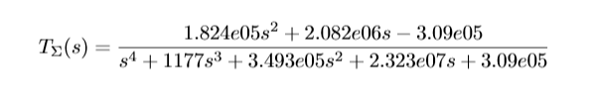
Transfer Function

Slide 11



Stakeholders
Individual
Average person experiencing daily stress
Employers
Care about maximizing staff productivity
Government
Canadian Government requires safety regulations to be met
Notes:
Should we put stakeholder needs here?

Slide 12


Stakeholders
Drug Industry
Pharmaceuticals, Alcohol and Illegal Drug
Healthcare Industry
Reduce burden on healthcare industry

Slide 13
Criteria and constraints
Cost less than $100
Minimize overshoot
Meet requirements of Medical Device Regulations under the Food and Drugs Act
Maximize comfort for the user
Reduce employers' losses due to stress by $300 annually per employee

Slide 14
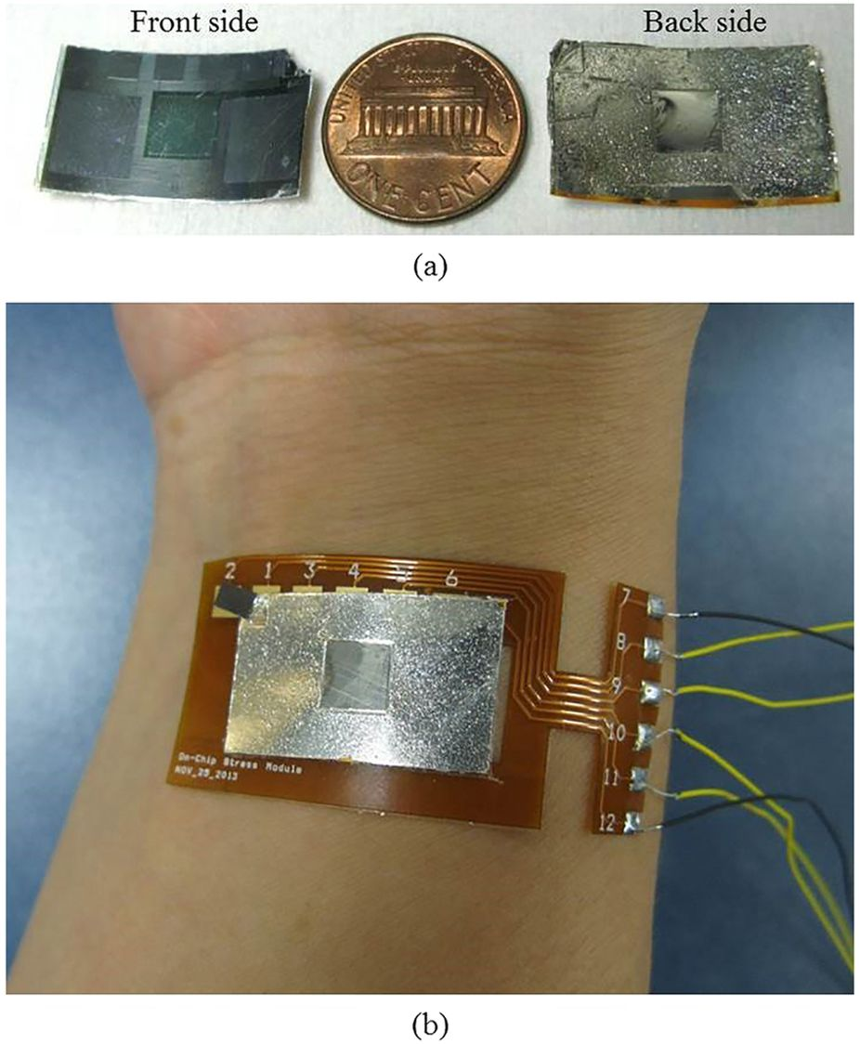
Design Problem Analysis + Solution
A wearable stress controller
Monitors heart rate, temperature and skin conductance to determine stress level of the wearer
Uses micro-doses of short-acting stimulant and depressant to regulate stress level needed for daily function and user specified tasks
Injections done using micro-needle drug injection patch
Notes:
This slide should expand a little bit. Or at least spend a while on it. JUSTIFY WITH STAKEHOLDER NEEDS

Slide 15
Control System
Cortisol and
Clonazepam
Desired Level of Stress
PID Controller
Human Body
Measured Level of Stress
+
-

Slide 16
Tuning the controller
Steady-State Error | Rise-Time (s) | Overshoot | Settling Time (s)
± 0.12 | 12 | 0.2 | 12

Slide 17
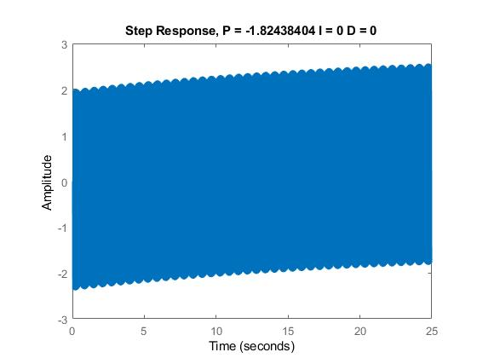
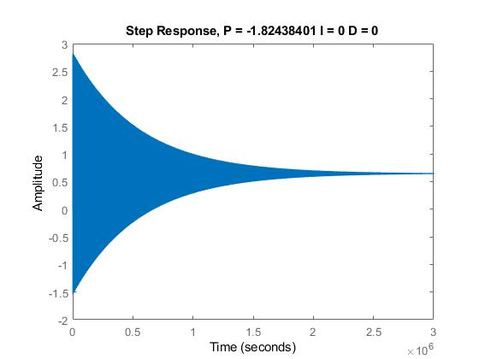
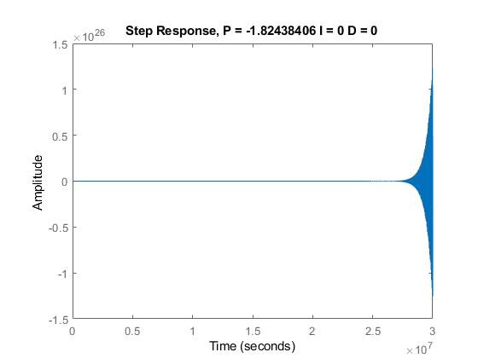
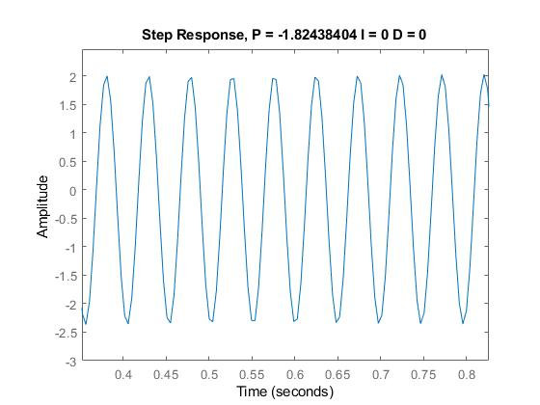
Ziegler-Nichols
Ku
P = 7 Ku / 10
I = 1.2 Ku / Tu
D = 3 Ku Tu / 40
Conclusion: Unstable
Tu
Notes:
Explain how Ziegler-Nichols is done.
Comment on extreme sensitivity of the system

Slide 18
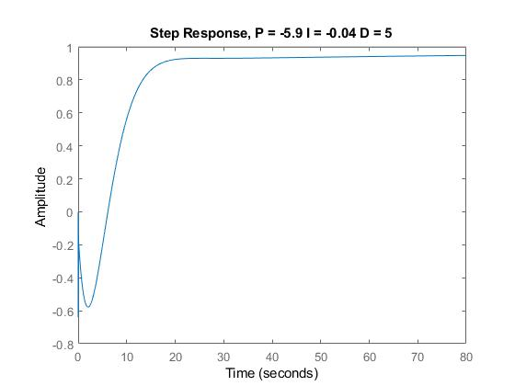
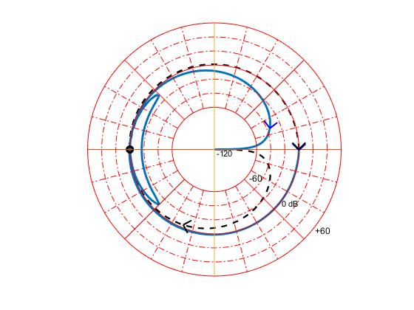
Final
P = -5.9
I = -0.04
D = 5
Steady State Error:
-0.069
Rise Time: N/A
Overshoot: N/A
Settling Time: 23.4
Notes:
Manual tuning was done, leaning heavily on the nyquist criterion.
First the proportional gain was determined to be negative, where it was then increased in magnitude until the system became unstable. Increasing the gain brought the nyquist plot closer and closer to circling –1.
At that point, the derivative gain was increased
Final plot has 0 encirclements of the –1, to correspond with the 0 RHP poles.

Slide 19
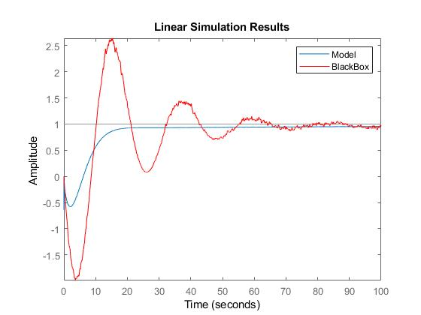
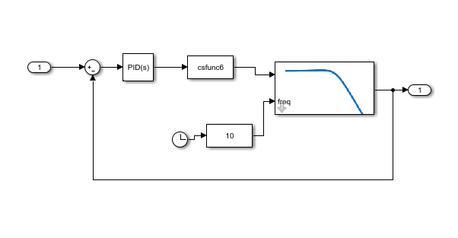
Assess Solution
Notes:
Other notes:
Talk about use of github and Matlab
Overdose; no overshoot allowed, take longer to reach desired values
•Dependency; safety measures to control dosage of user and length of time spent at high risk stress levels (too low or too high)
Graphics: Figures and tables eﬀectively summarize complex information to compliment and enhance dicussion of concepts or ﬁndings
Oral Communication: Demonstrates a distinct enthusiasm, makes the topic interesting, and does not use space ﬁllers, or memory aids. Uses slides as a guide, but does not rely on slides for content. Thoughtful and professional response to questions
Professional Bearing: Demonstrates exemplary professional skills as expected in the workplace/industry of engineering i.e. formal language, respectful of peers and colleagues contributions etc
TBL: Report discussion conveys how relevant factors were explicitly applied in shaping the overall direction of the design and explicit impacts on Triple Bottom Line.
Emphasize iterative process

Slide 20
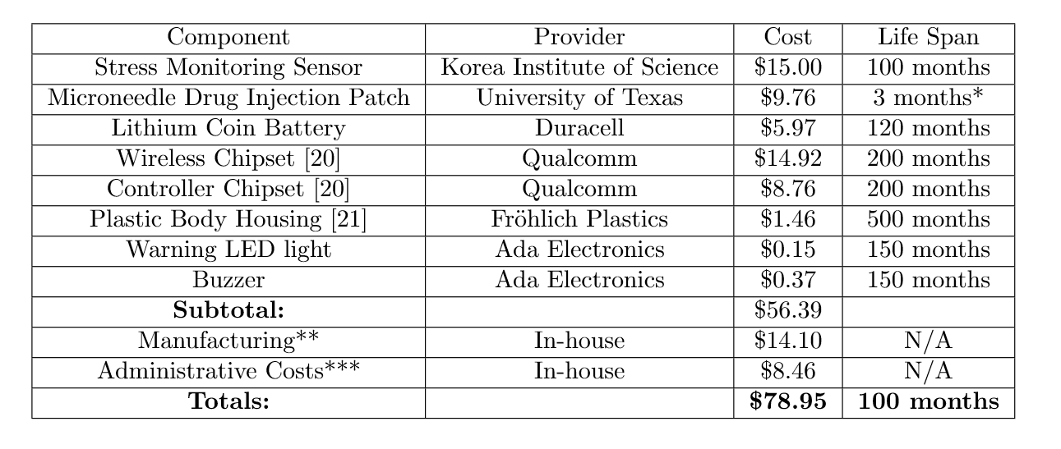
Economics: Controller Bill of Materials

